Slide 1
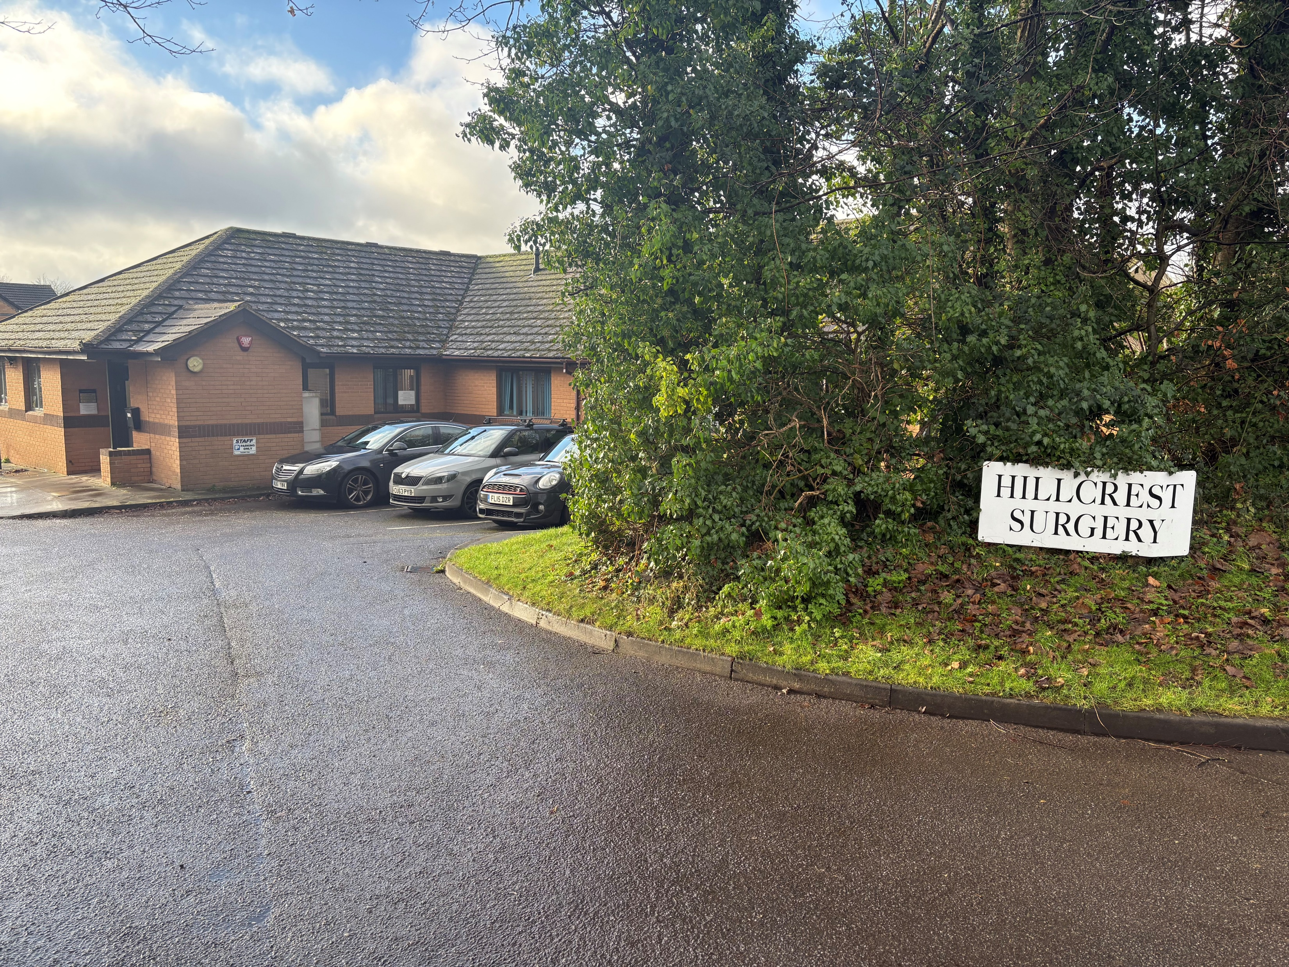
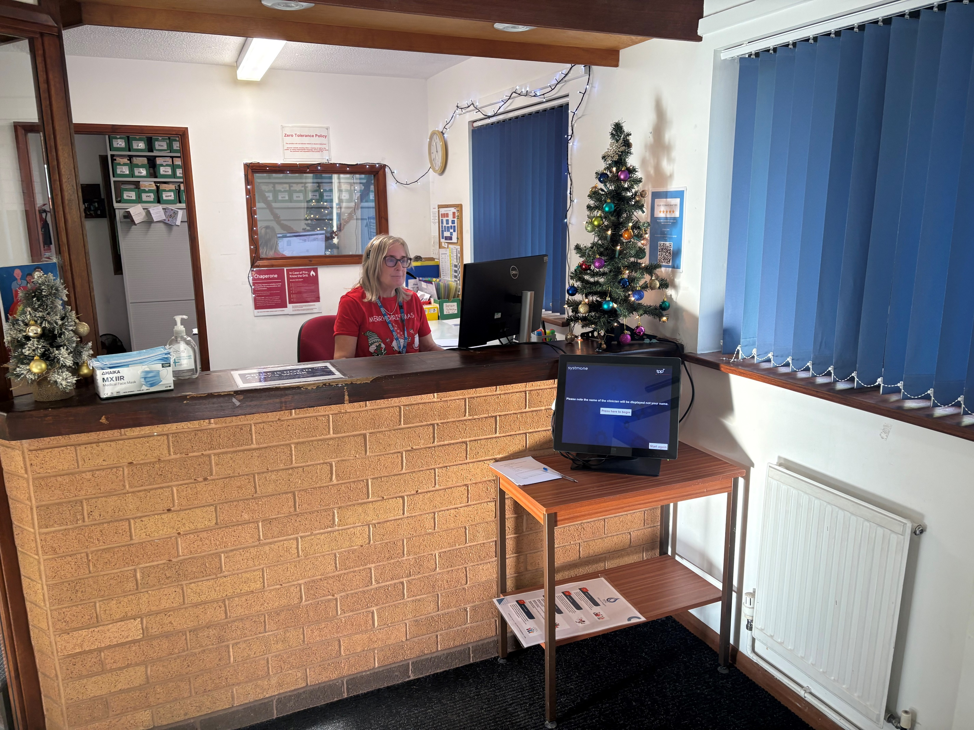
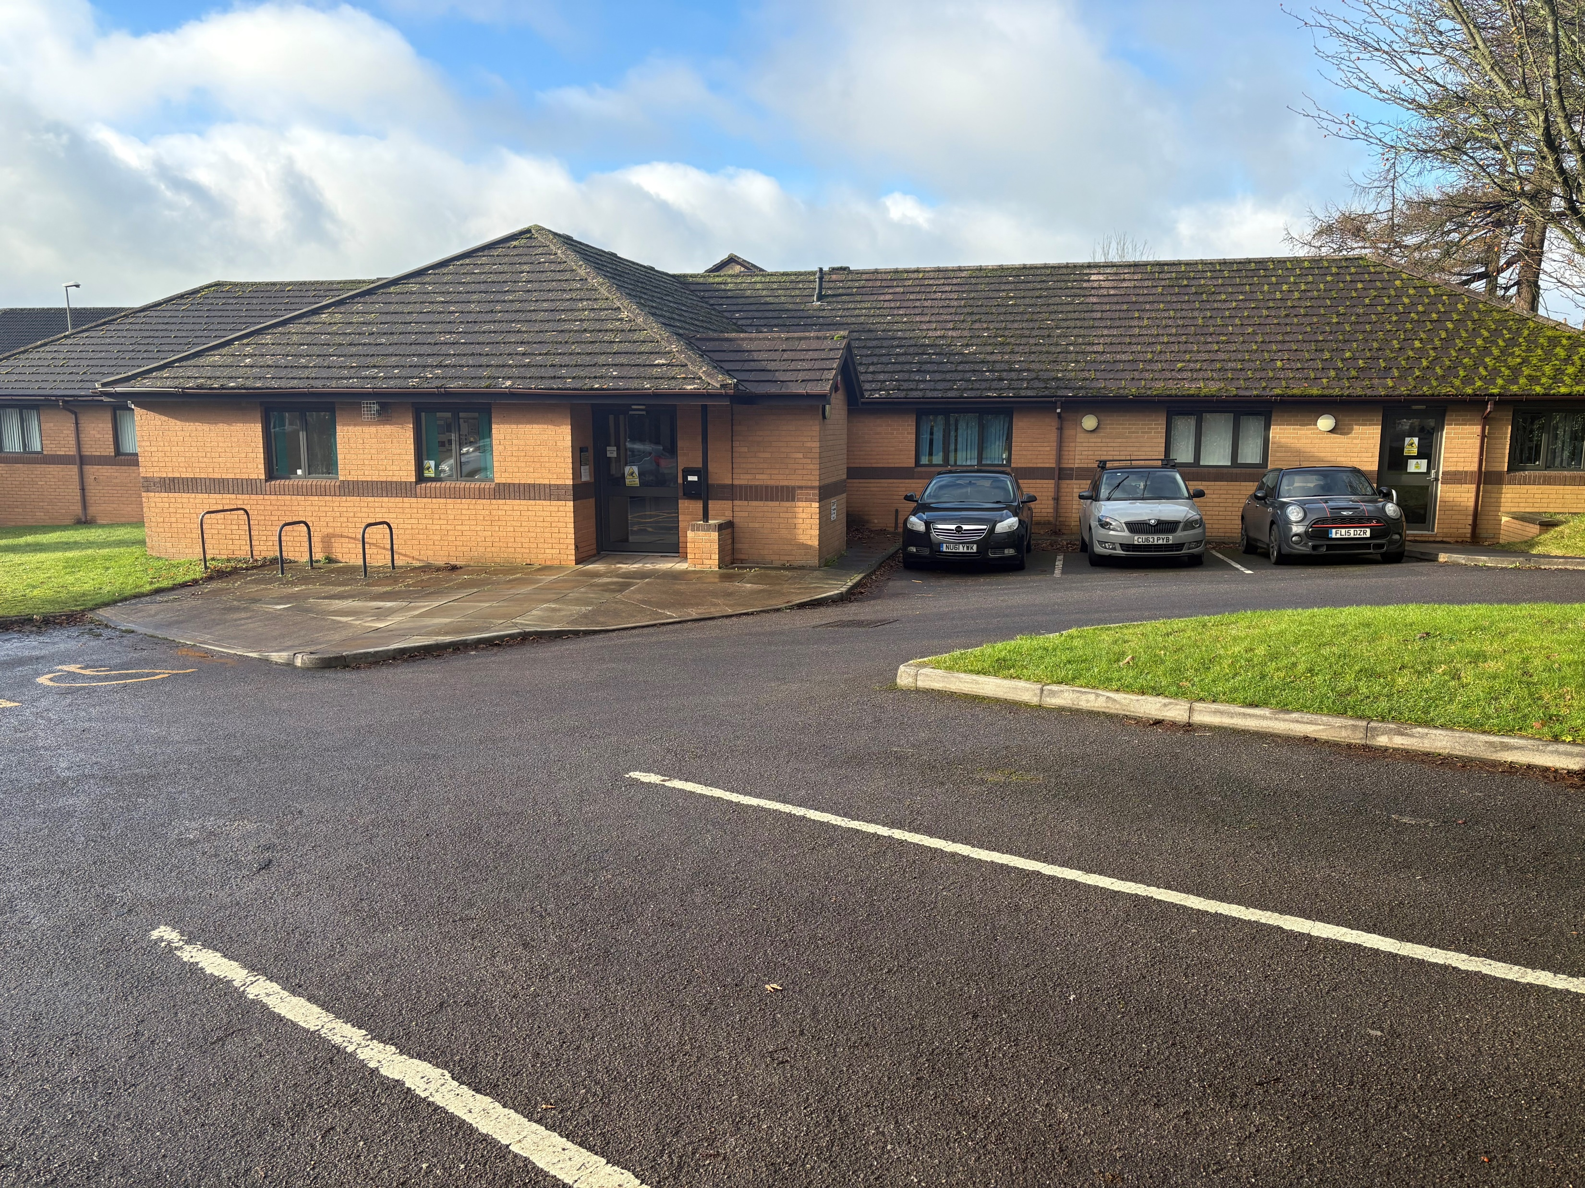
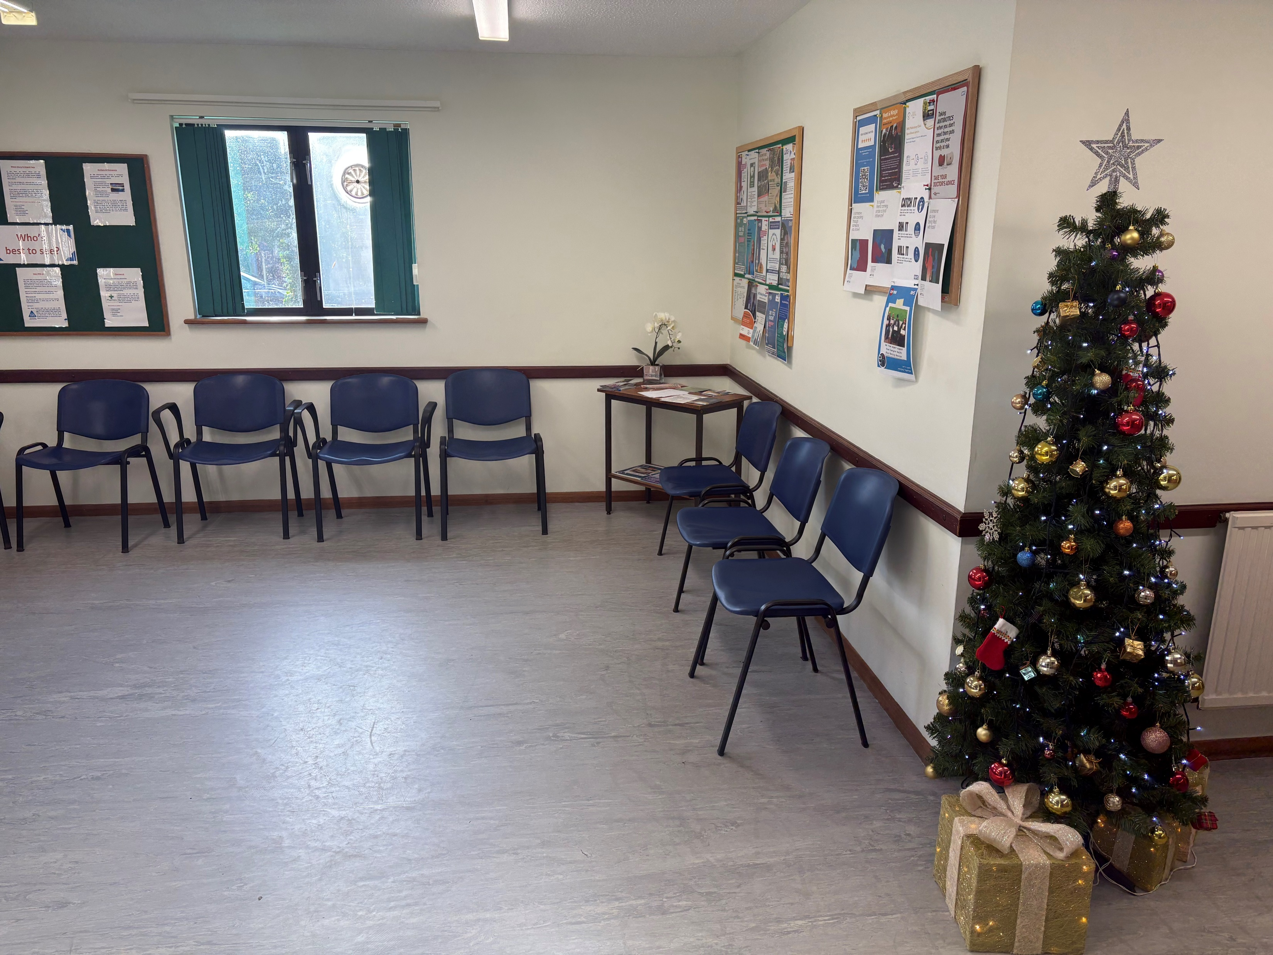
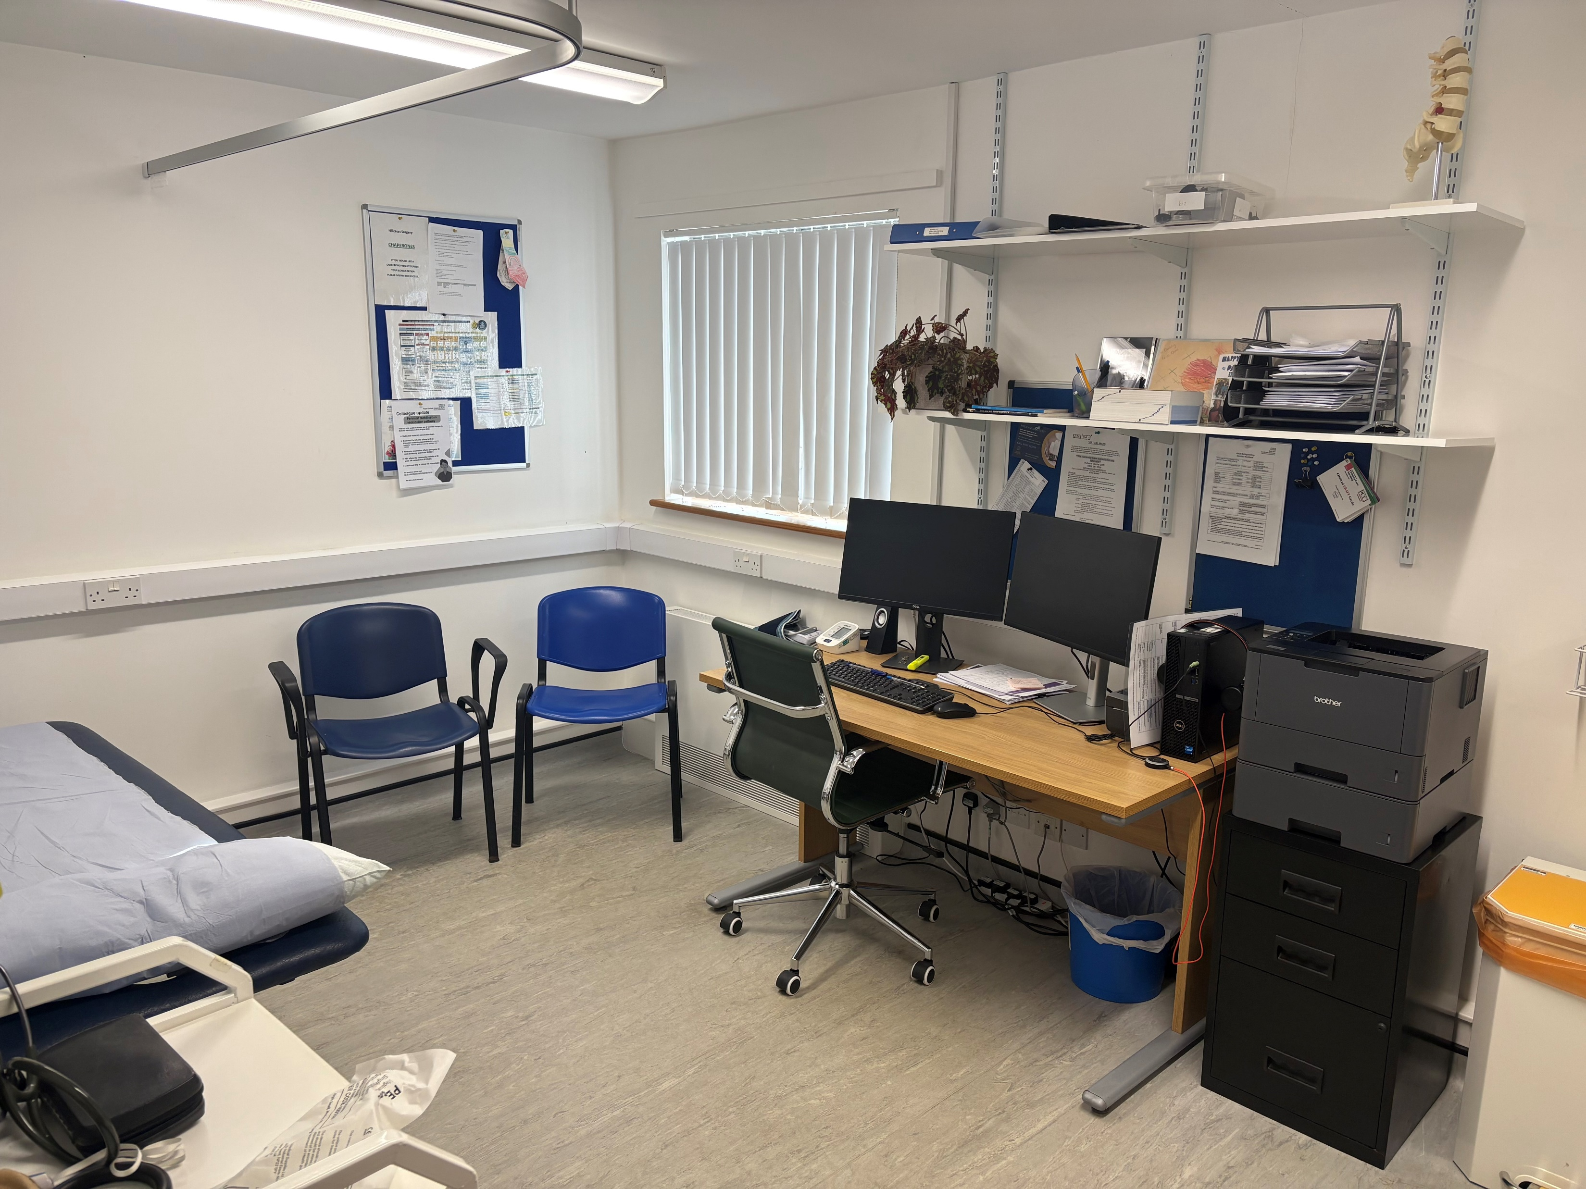
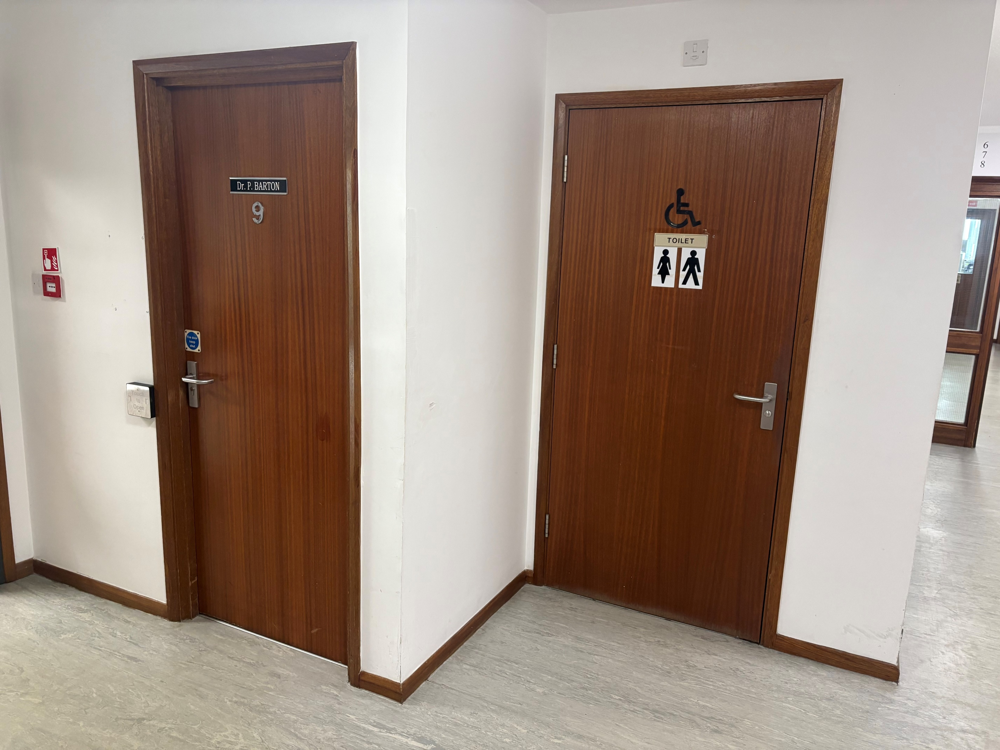
Hillcrest Surgery
“Here is our Surgery”
“Here is our Reception Area”
“Here is our Car park”
“Here is our Waiting Area”
“Here is the Toilet”
“Inside one of our Clinical Rooms”

